Slide 1
Introduction to Reinforcement Learning
Instructor: Mohammad Hasan
Office: 13-240
11/16/26
Notes:
Welcome and Introductions

Slide 2
Overview
What is reinforcement Learning
States, Actions, Rewards and MDPs
Value of a State and the Action-Value function
The Bellman Equation

Slide 3
Machine Learning Types
Machine Learning
Supervised Learning
Unsupervised Learning
Reinforcement Learning (RL)
Regression
Classification
Predict a number from a continuous space (example: temperature of a room)
Predict a category or a number from a discrete set

Slide 4
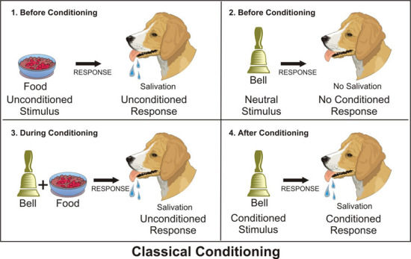

Teaching by Doing
General way to train animals and robots 🤖.
Provide clear connections between actions and rewards
Reinforce the relationship with repetition
This is the basis of RL

Slide 5
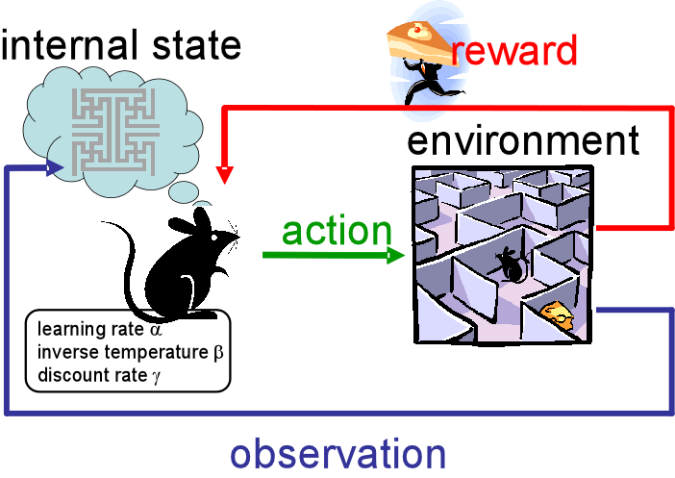


Reinforcement Learning
A ML scheme that is based on agents interactions with environment to receive rewards.
Data is collected through interactions with environment.
Rewards are to be maximized in this scheme.
Agent

Slide 6
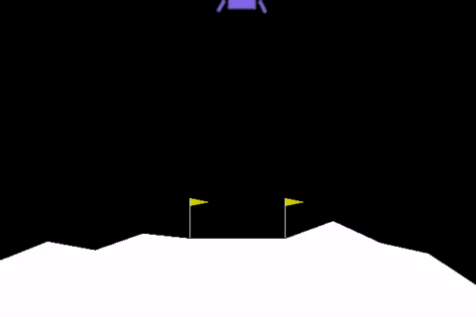
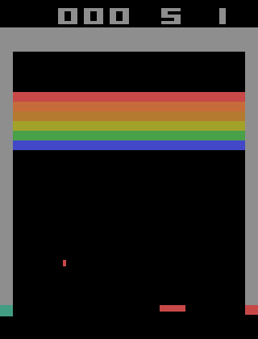
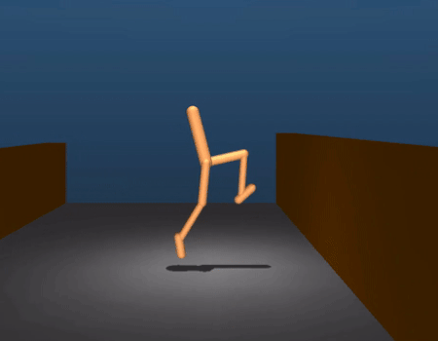
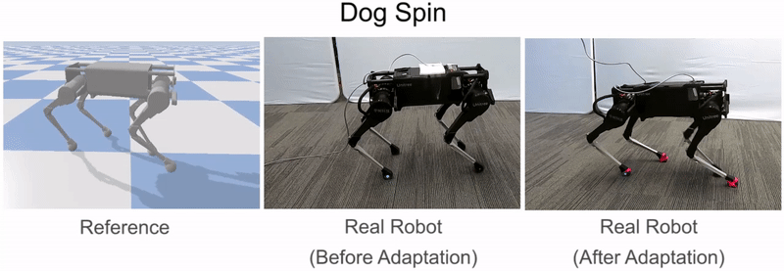
Reinforcement Learning Applications
Control applications
Robot locomotion
Playing games

Slide 7
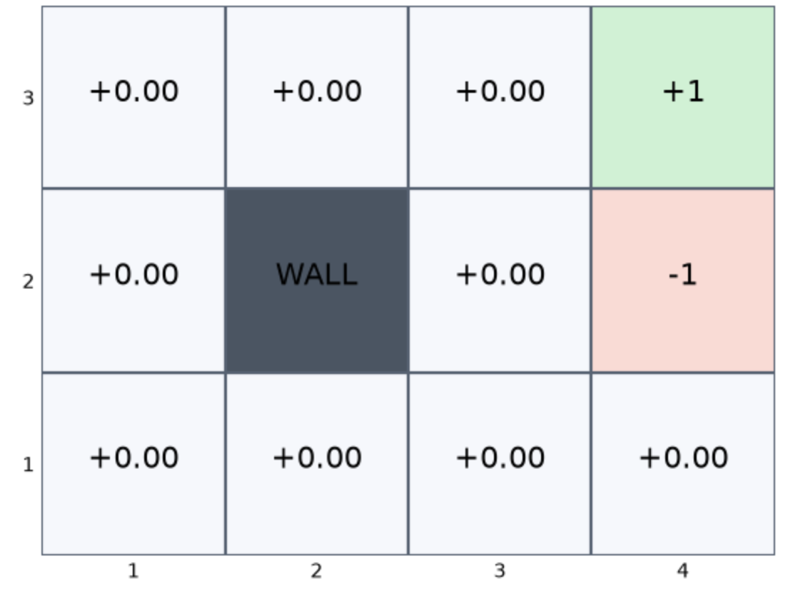
Reinforcement Learning Terminology
Reinforcement Learning uses unique sets of terms.
In reinforcement learning, we do not use the terms ‘feature’ and ‘label’ for machine learning ‘inputs’ and ‘outputs’.
We will consider a grid-navigation maze problem to illustrate our concepts.
Goal: learn to reach the +1 grid.

Slide 8
RL Terminology (States)

Slide 9
RL Terminology (Actions)

Slide 10
RL Terminology (Transition Model)

Slide 11
RL Terminology (Rewards)

Slide 12
Markov Decision Process MDP
A sequential-decision problem for a fully-observable, stochastic environment with Markovian transition model and additive rewards is called a Markov Decision Process (MDP).
State transitions in an MDP can be represented as graphs.

Slide 13
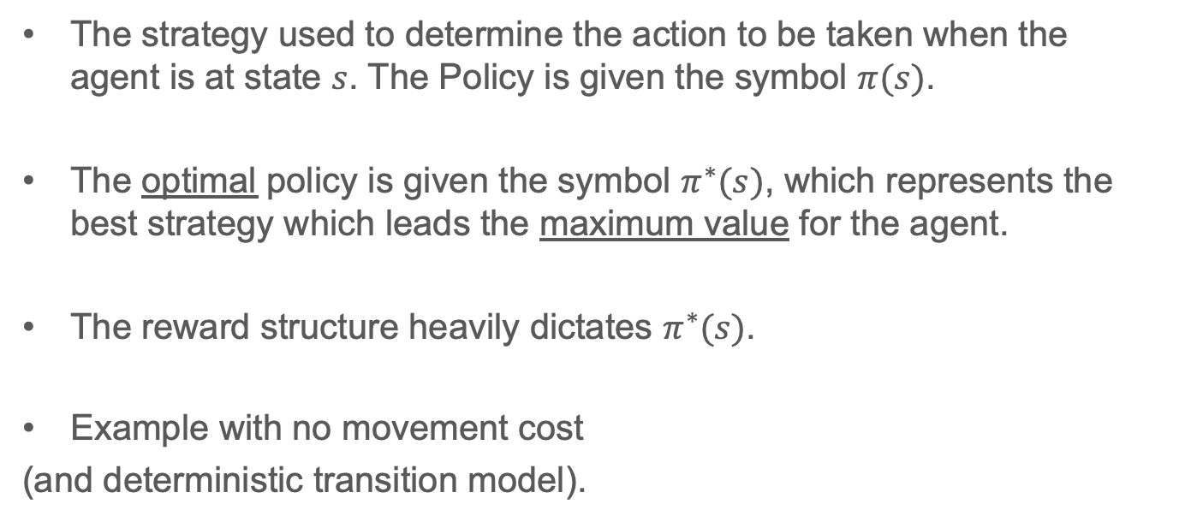
RL Terminology (Policy)
The strategy used to determine the action to be taken when the agent is at state $s$. The Policy is given the symbol $π(s)$.
The optimal policy is given the symbol $π^{∗}(s)$, which represents the best strategy which leads the maximum value for the agent.
The reward structure heavily dictates $π^{∗}(s)$.
Example with no movement cost
(and deterministic transition model).

Slide 14
Setting up RL Example

Slide 15
Setting up RL Example

Slide 16
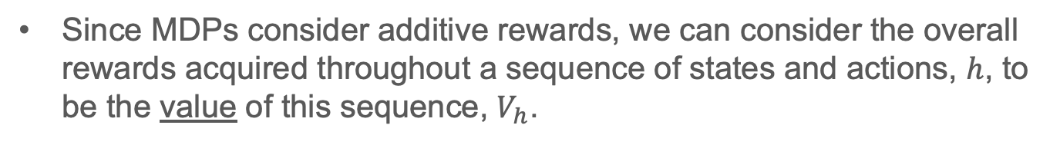
Value over time
Since MDPs consider additive rewards, we can consider the overall rewards acquired throughout a sequence of states and actions, $h$, to be the value of this sequence, $V_{h}$.

Slide 17
Why use a Discount Factor?
Biological/psychological reasons
Cost
Uncertainty of the future
Limiting effects of the far future

Slide 18
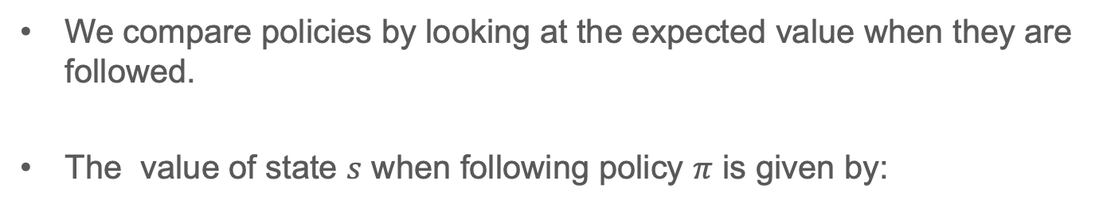
Optimal Policies and the Value of States
We compare policies by looking at the expected value when they are followed.
The value of state $s$ when following policy $π$ is given by:

Slide 19
Why Use a Discount Factor?

Slide 20
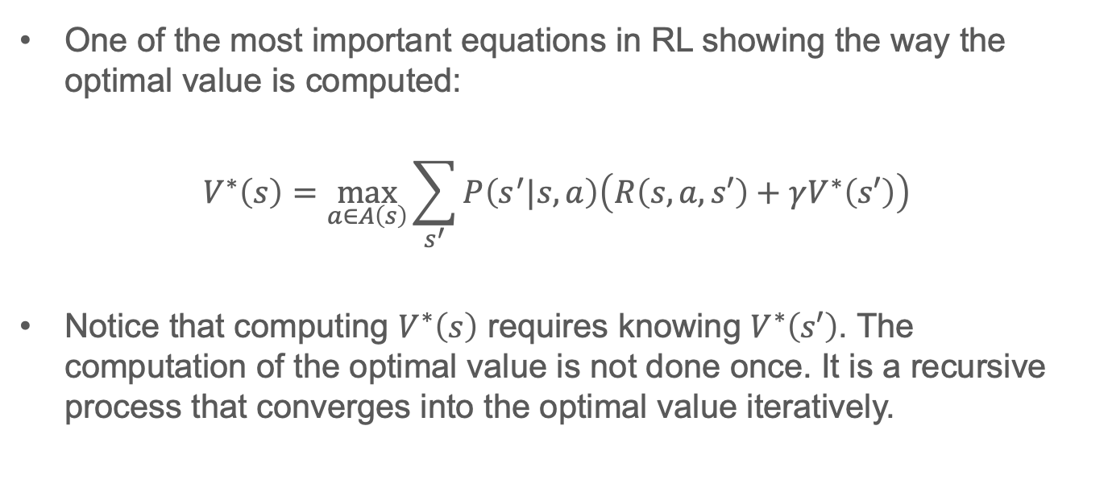
The Bellman Equation
One of the most important equations in RL showing the way the optimal value is computed:
$$V^{∗}\left(s\right)=\max_{a∈A\left(s\right)}{\sum_{s^{′}}{P\left(s^{′}|s,a\right)\left(R\left(s,a,s′\right)+γV^{∗}\left(s′\right)\right)}}$$
Notice that computing $V^{∗}\left(s\right)$ requires knowing $V^{∗}\left(s′\right)$. The computation of the optimal value is not done once. It is a recursive process that converges into the optimal value iteratively.

Slide 21
Example
Consider the grid maze with the same transition model indicated previously and for a step cost of -0.04 for each transition to a non-terminal state. We want to find the state values when following the optimal policy.

Slide 22
Cont. Example

Slide 23
Cont. Example

Slide 24
Cont. Example

Slide 25
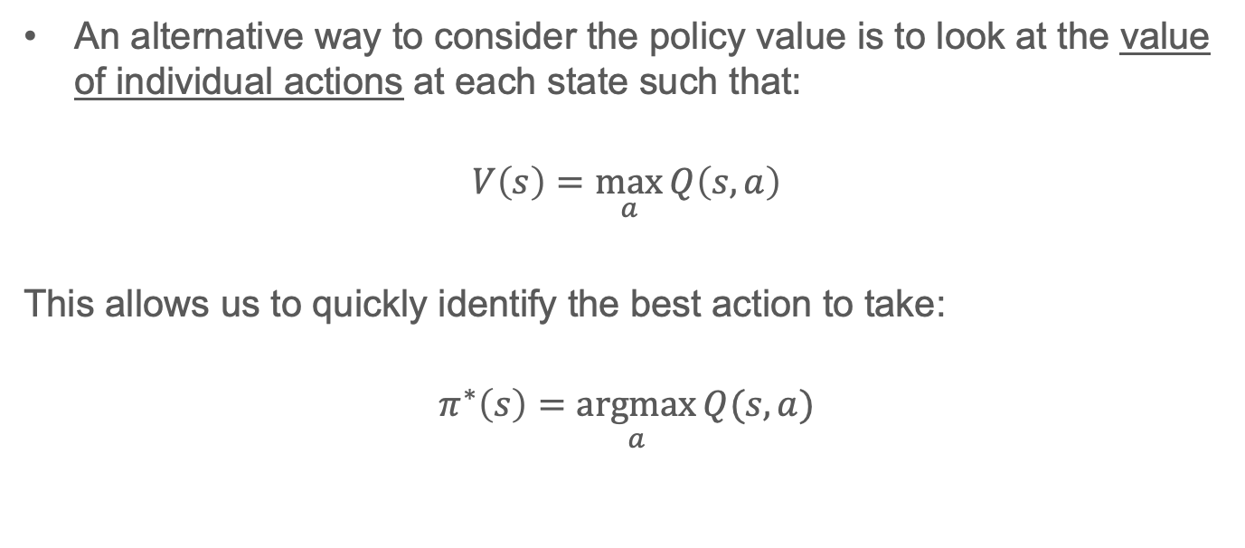
Action-Value Function (Q-function)
An alternative way to consider the policy value is to look at the value of individual actions at each state such that:
$$V\left(s\right)=\max_{a}{Q\left(s,a\right)}$$
This allows us to quickly identify the best action to take:
$$π^{∗}\left(s\right)=\underset{a}{argmax}{Q(s,a)}$$

Slide 26
Bellman Equation for Q-functions
The Bellman equation can be modified to be used for the Q-function:

Slide 27
References
Machine Learning, A Modern Approach, 4th edition, by S. Russel and P. Norvig, Sections 17.1.1 and 17.1.2

Slide 28
Extra Notes

